Slide 1



iRevolution: A Data-driven Exploration of Apple's iPhone Impact in India
SUBMITTED BY
PAVITHRA G 36821U25022
THRISHA V 36821U25036
DIVYA E M 36821U25009
DEVAKI T K 36821U25006
Under the Guidance of
Dr. S. RAJAVEL, M.Sc., M.Phil., Ph.D., B.Ed.
DEPARMENT OF MATHEMATCS
GOVERNMENT ARTS AND SCIENCE COLLEGE (Jambukulam) , SHOLINGHUR-631102, RANIPET DISTRCT,
TAMIL NADU.

Slide 2
INTRODUCTION :
One year after Apple Inc. CEO Steve Jobs announced the company’s industry-changing iPhone on January 9, 2007, at the Macworld convention in San Francisco, the share price of Apple’s stock has more than doubled to a January 9, 2008, value of $179.40. This stock price incorporates all of Apple’s business, but a large part of the rise in value can be attributed to the launch of the cutting-edge iPhone, of which four million have already been sold through mid-January 2008 (Carew, 2008). Based on this simple observation of the stock price, the iPhone can so far be declared a success, at least from a shareholder standpoint. This paper will explore both the pre- and post-launch activities surrounding the iPhone to explain why it was such a success for the stockholders and why Apple’s reputation for unparalleled marketing success is deserved.

Slide 3
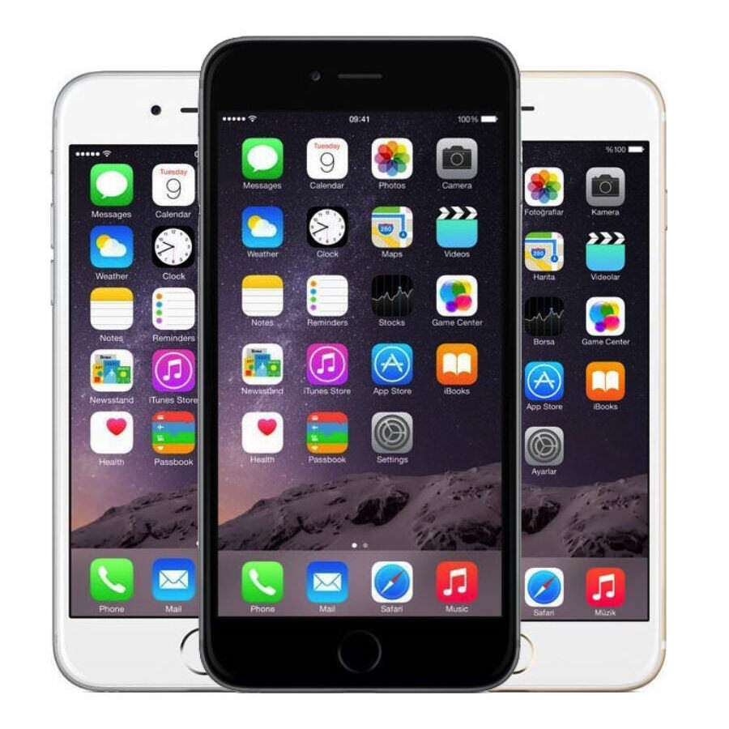

Slide 4
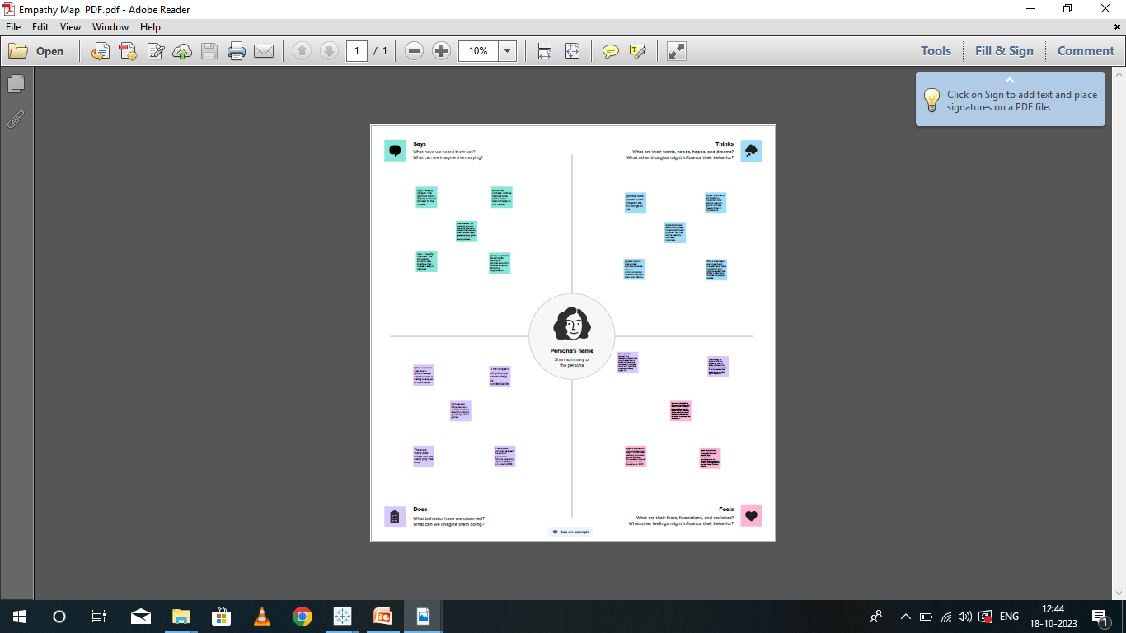
EMPATHY MAP

Slide 5
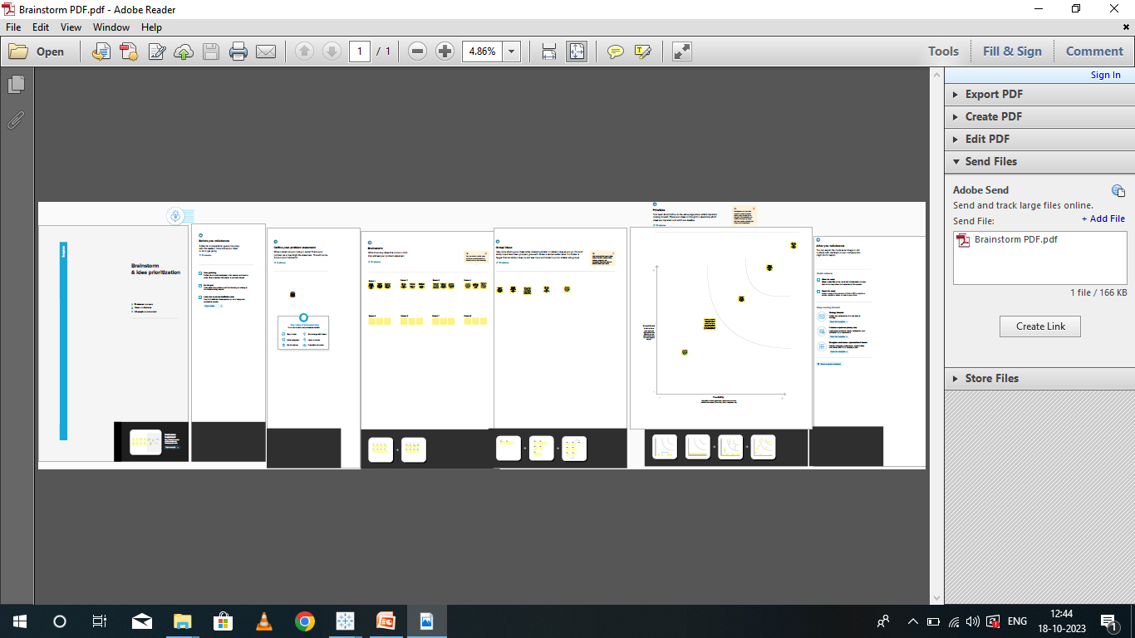
BRAINSTORM

Slide 6
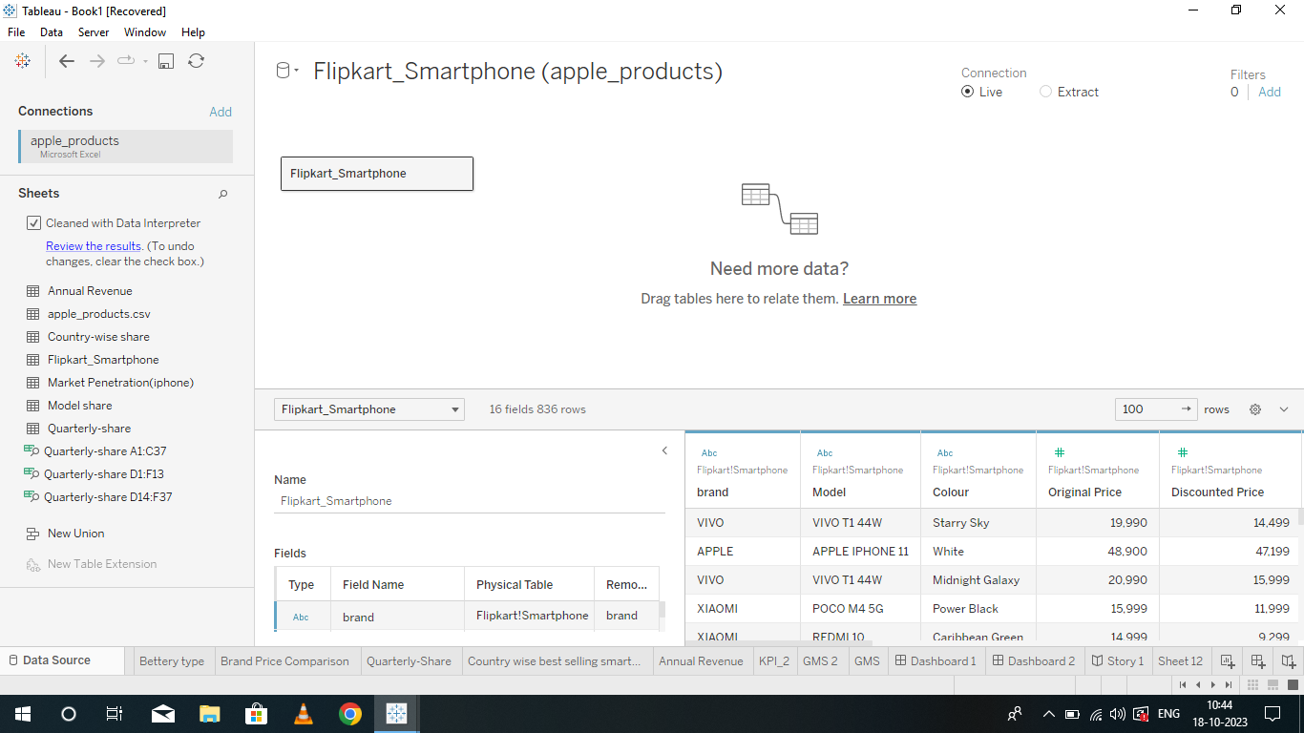
DATASOURCE

Slide 7
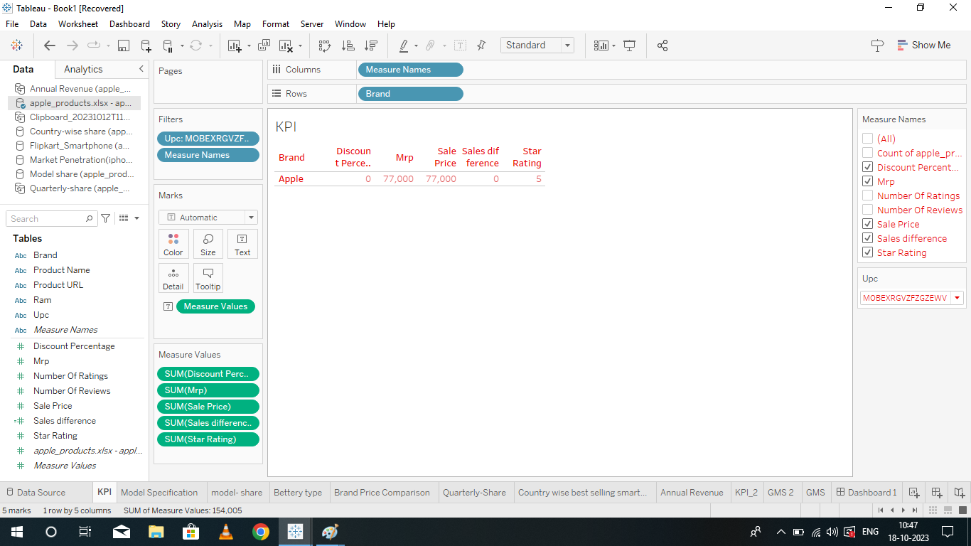
KPI

Slide 8
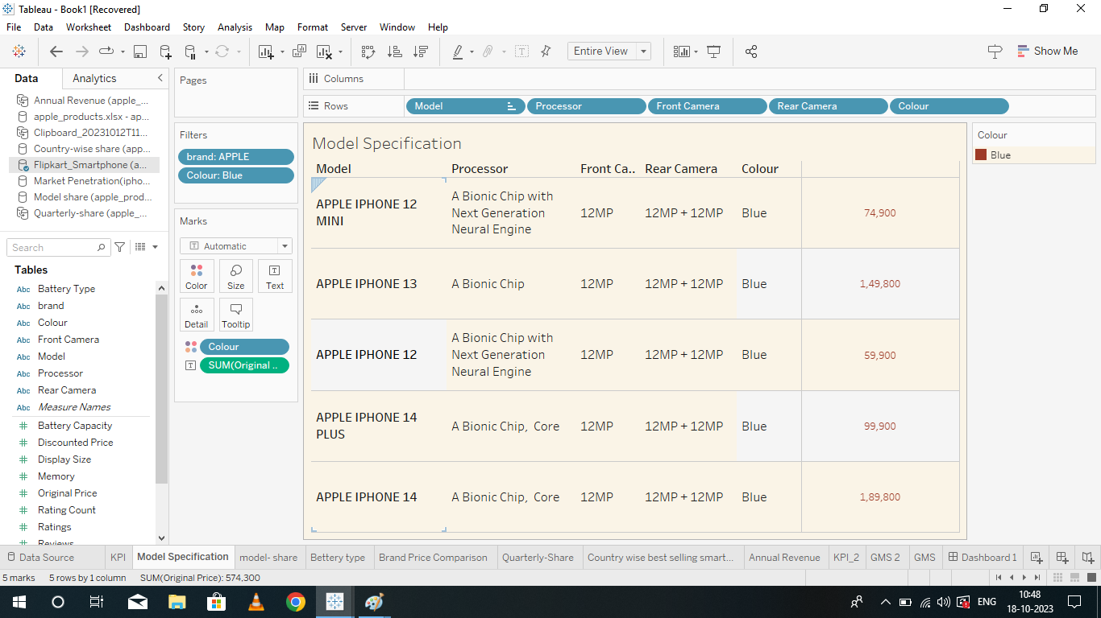
MODEL SPECIFICATION

Slide 9
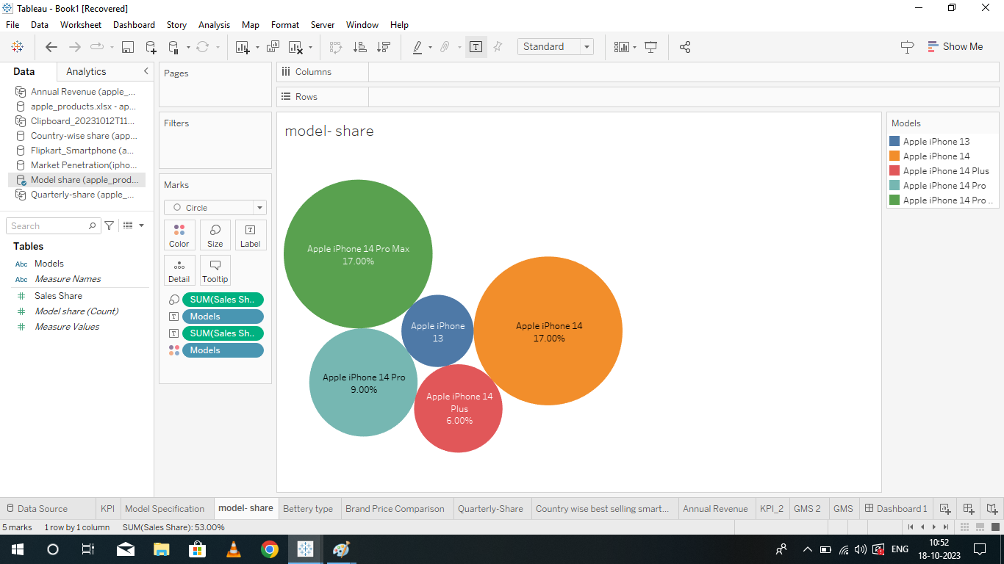
MODEL SHARE

Slide 10
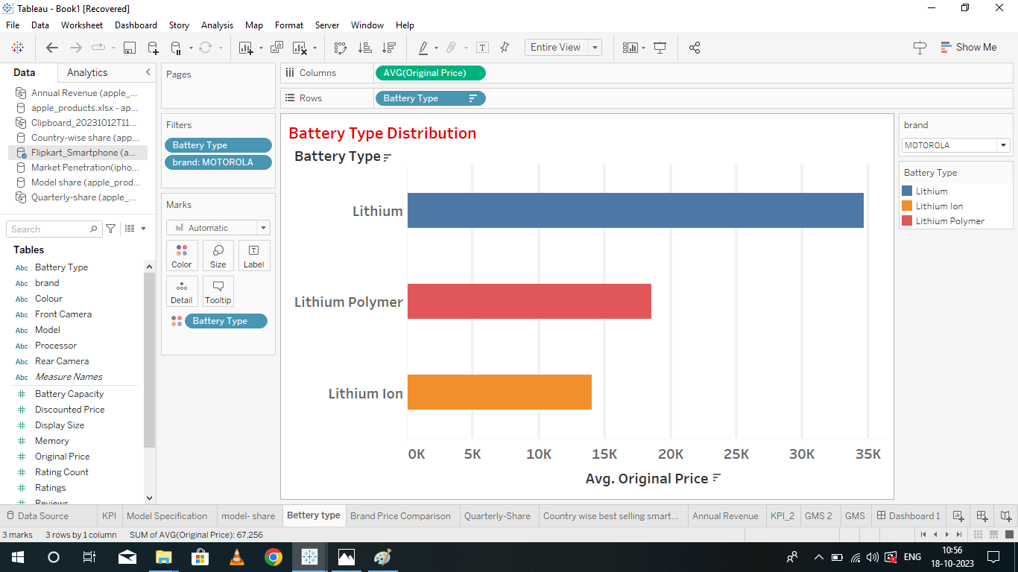
BATTERY TYPE DISTRIBUTION

Slide 11
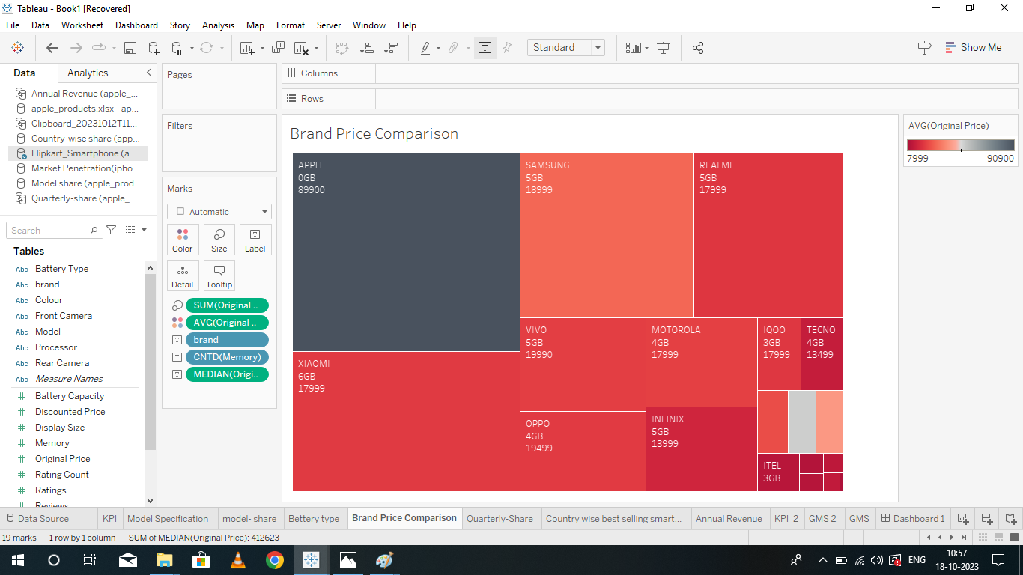
BRAND PRICE COMPARISON

Slide 12
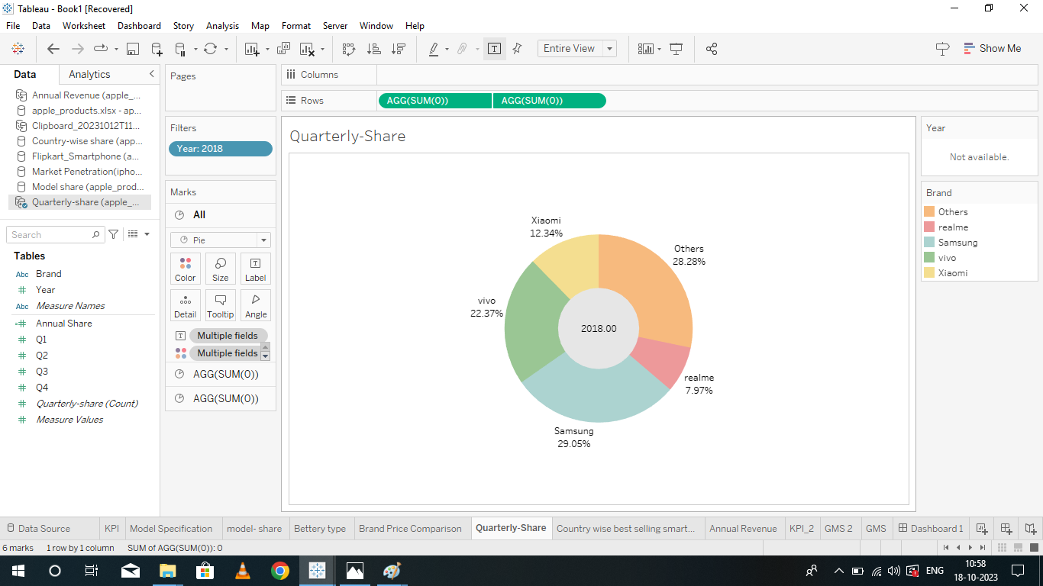
QUARTERLY SHARE

Slide 13
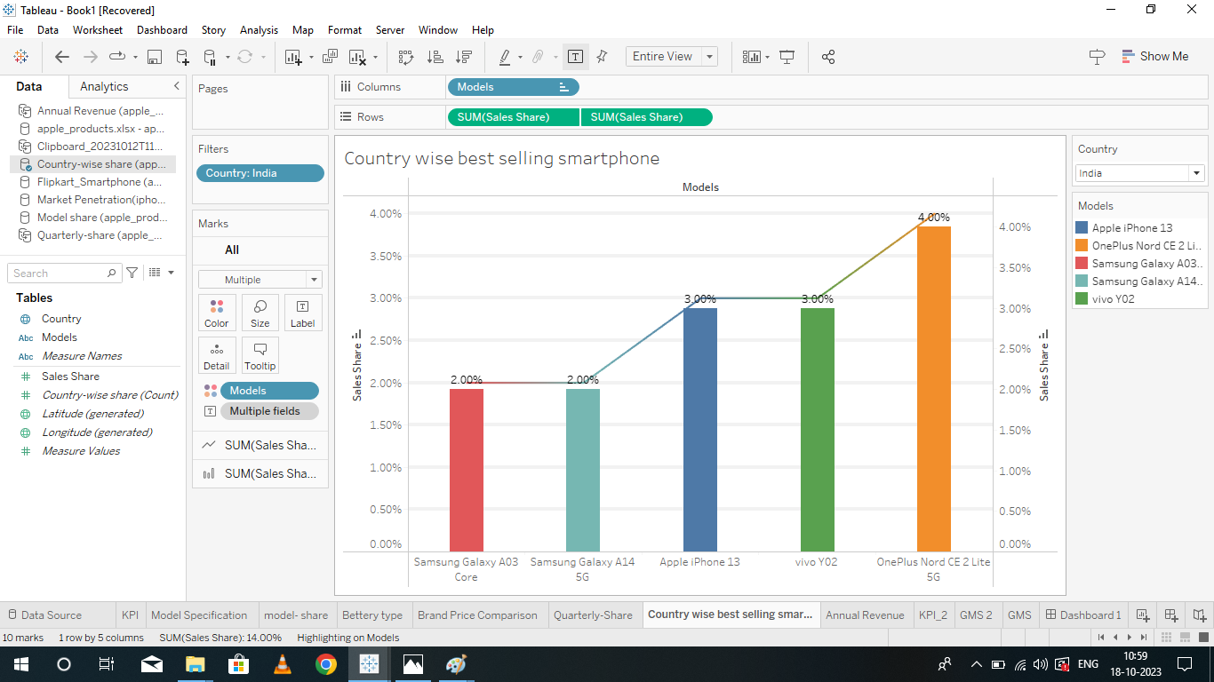
COUNTRY WISE BEST SELLING SMARTPHONE

Slide 14
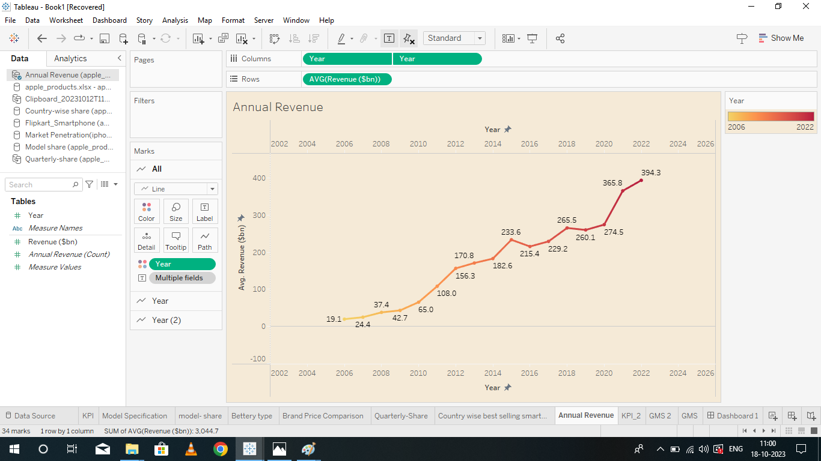
ANNUAL REVENUE

Slide 15
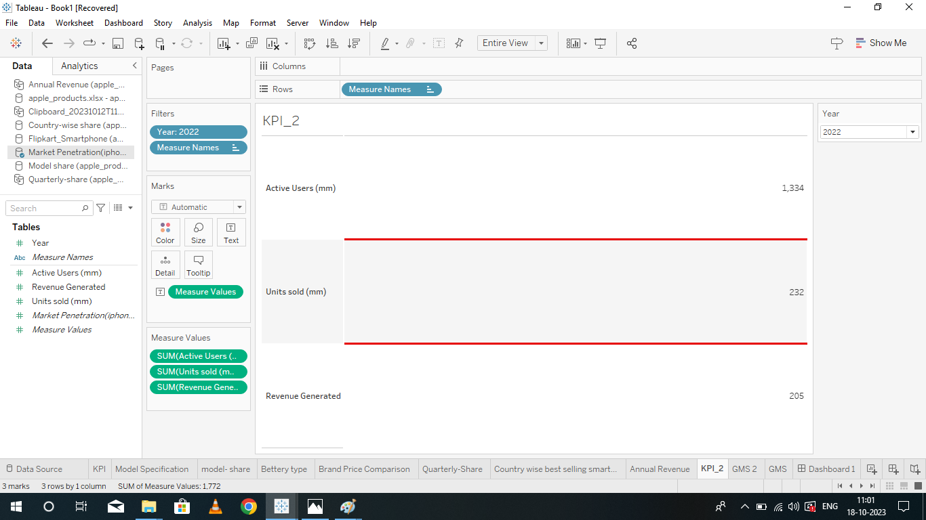
KPI-2

Slide 16

GLOBAL MARKET SHARE

Slide 17
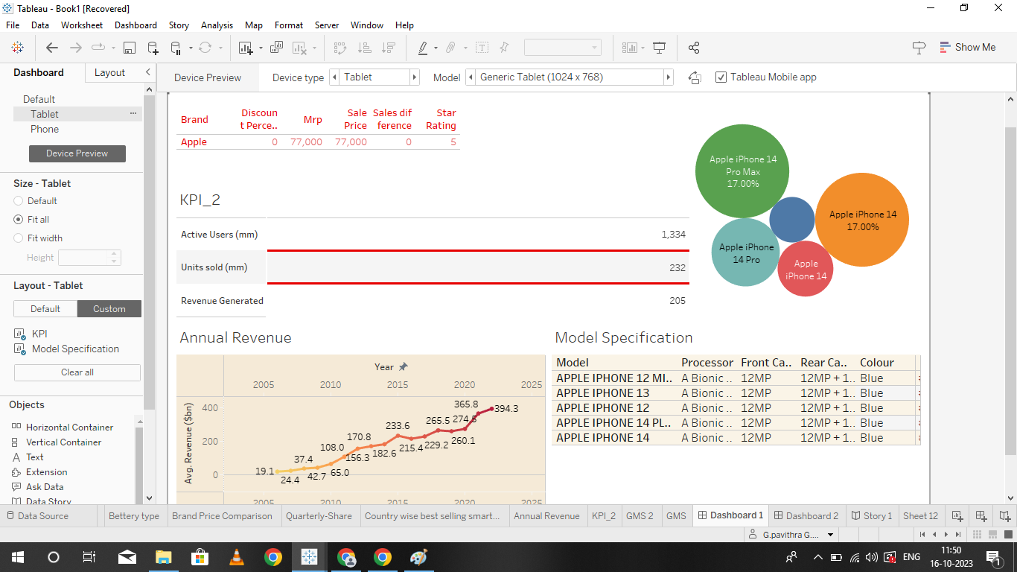
DASHBOARD 1

Slide 18
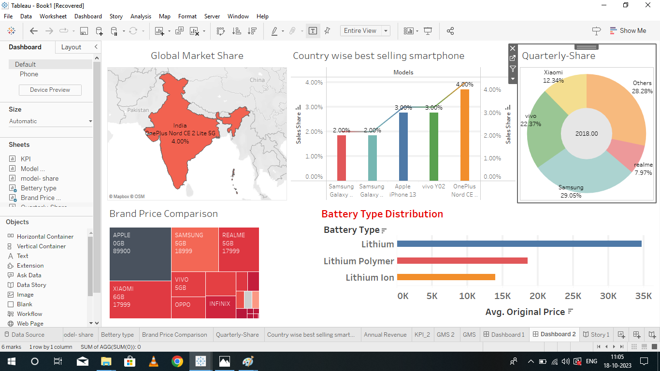
DASHBOARD 2

Slide 19
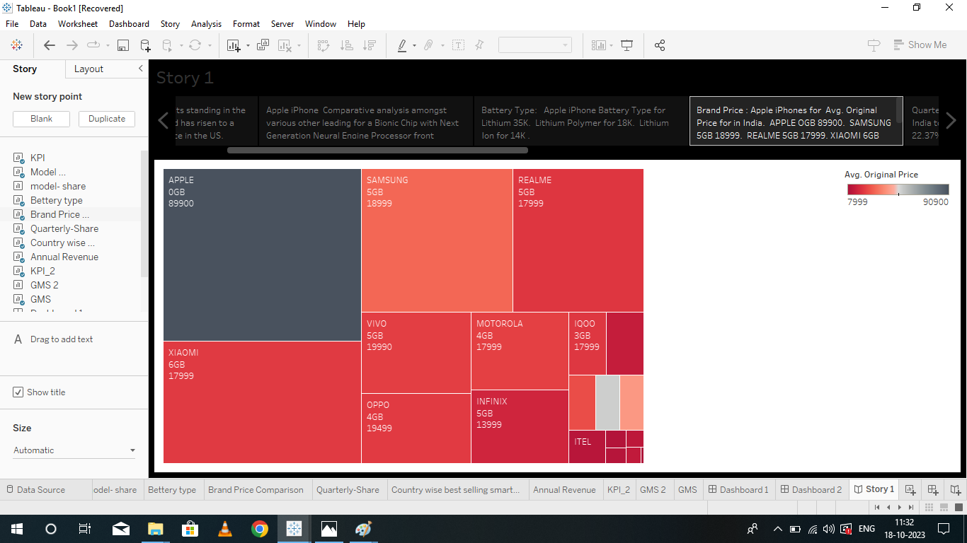
STORY

Slide 20
ADVANTAGES OF THE iPHONE
1 .User-Friendly Interface
2.High-Quality Display
3.Advanced Camera
4.Apps Ecosystem
5.Seamless Integration with other Apple device

Slide 21
DISADVANTAGES OF THE iPHONE
1.Cost
2.Non-Removable Battery
3.Limited Customization
4.No Expandable Storage
5.Frailty

Slide 22
CONCLUSION
Apple created a very strong overall marketing strategy for the iPhone and managed every aspect of the iPhone’s launch very effectively. Like almost all products, the iPhone has some flaws and drawbacks, but Apple was able to develop a unique product for tech-savvy consumers interested in a combination smart phone-music player and make those customers aware of the product through well-managed marketing efforts and strong publicity. The iPhone exemplifies Apple’s knack for creating excitement about products among its fiercely loyal customer base, who keep attention focused on the company, and then justify the hype by delivering a high-quality, desirable product. In addition to satisfying consumers with a great product, Apple built a powerful partnership with AT&T and also conferred benefits to overseas suppliers of parts and manufacturers. All of these efforts boosted Apple’s stock price considerably and further solidified Apple’s image as a leader in consumer electronic gadgetry.

